Slide 1
A Note on Mixed Tree Coloring
Hanna Furma´nczyk, Adrian Kosowski and Paweł Zyli´nski
Information Processing Letters 106 (2008), pp. 133–135
Presenter : Hsiang-Yi Weng
Date : October 6, 2008

Slide 2
Abstract
In this note we observe that the problem of
mixed graph coloring can be solved in linear
time for trees, which improves the quadratic
algorithm of Hansen et al.

Slide 3
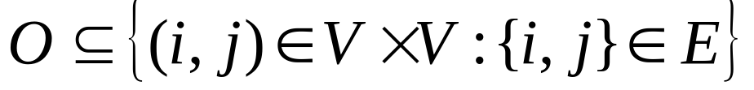
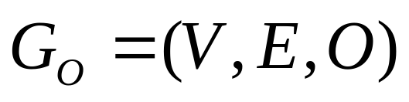
Mixed Graph
G=(V, E) be a simple graph of order |V|=n
Let O be an orientation of some subset of its edges, , which does not induce directed circuits.
is called a mixed graph.

Slide 4
Mixed Graph
(a) Mixed Graph
(b) It is not a mixed Graph

Slide 5
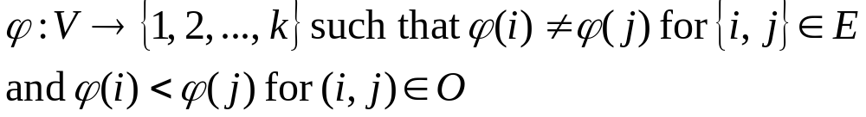
A k-coloring of G_{O}
The smallest k for which G_{O} has a k-coloring is called the chromatic number of mixed graph G_{O}

Slide 6
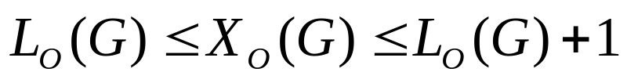
In particular, when G is bipartite, there are only two possible values
1
3
4
3
2
1

Slide 7
2
1
3
5
5
2
4
1
5
5
5
5

Slide 8
r
x ∈ X (v)
v
y ∈ Y (v)
y
let Z(v) be the set of all the
remaining neighbors of v.
x

Slide 9
Function Φ has the following recursive (bottom-up) characterization:
[1, k]
[1, k]
[1, k]
[1, k]
[1, k]
[1, k]
[1, k]

Slide 10
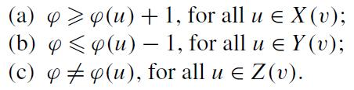
Function Φ has the following recursive (bottom-up) characterization:
[1, k]
[1, k]
[1, k]
[1, k]
[1, k]
[1, k]
[1, k]

Slide 11
Function Φ has the following recursive (bottom-up) characterization:
[1, k]
[1, k]
[1, k]
[2, k]
[1, k-1]
[1, k]
[1, k]
[1, k]
[1, k]
[1, k]

Slide 12
Function Φ has the following recursive (bottom-up) characterization:
[1, k]
[3, k-2]
[1, k]
[1, k]
[2, k]
[1, k-1]
[1, k]
[1, k]
[1, k]
[1, k]
[1, k]

Slide 13
Function Φ has the following recursive (bottom-up) characterization:
[2, k-1]
[1, k]
[3, k-2]
[1, k]
[1, k]
[2, k-1]
[1, k-1]
[1, k]
[1, k]
[1, k]
[1, k]
[1, k]

Slide 14
Algorithm 1.
Optimal coloring of a mixed tree in linear time.
k =5
3
2
4
1
5

Slide 15
Algorithm 1.
Optimal coloring of a mixed tree in linear time.
[2, 4]
k =5
[1, 5]
[3, 3]
[1, 5]
[2, 4]
[1, 4]
[1, 5]
[1, 5]
[1, 5]
[1, 5]
[1, 5]
[1, 5]

Slide 16
Algorithm 1.
Optimal coloring of a mixed tree in linear time.
2
k =5
[1, 5]
1
[3, 3]
3
5
[1, 5]
[2, 4]
2
[1, 4]
4
[1, 5]
5
[1, 5]
1
[1, 5]
1
[1, 5]
1
[1, 5]
5
[1, 5]
5

Slide 17
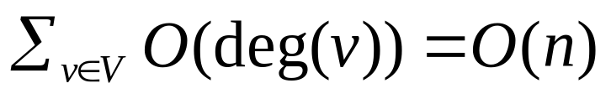

An optimal coloring of a mixed tree can be determined in linear time.
Linear time for finding the maximal length of a directed path in the orientation.
the optimal mixed k-coloring of T is also constructed in O (n) time in such a way that each node v is assigned one of the two permissible color values.

